Slide 1
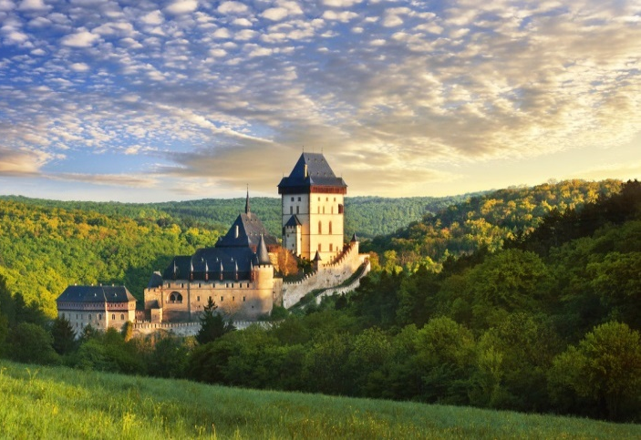
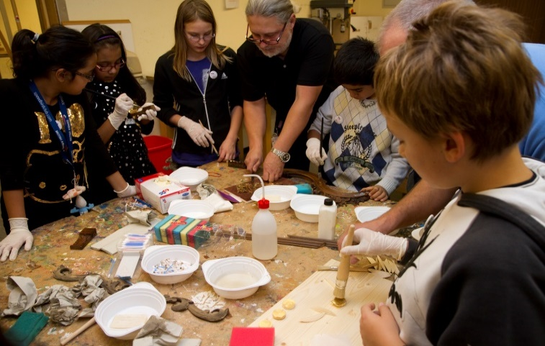
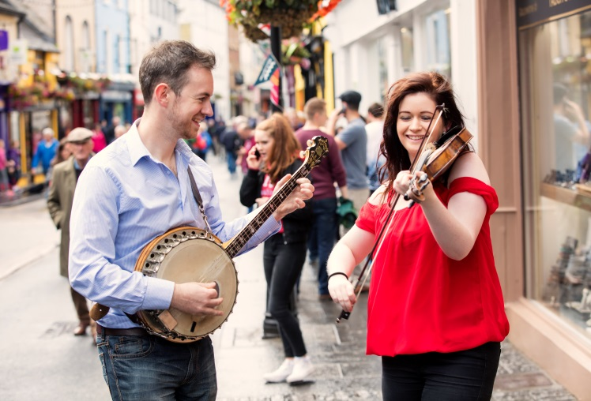
Opportunities and tools for culture: strategies and new approaches
Bruxelles, 18 June 2019

Slide 2
The „cultural” momentum
2014-2015 New EU policy framework for Cultural Heritage
G7 for Culture Ministers (Florence, March 2017)
EU Leaders' meeting (Gothenburg, November 2017)
European Year of Cultural Heritage 2018
Davos Declaration: European Ministers of Culture call for a policy of high-quality Baukultur (January 2018)
European Commission: New European Agenda for Culture (May 2018)
European Framework for Action on Cultural heritage (December 2018)
Council of the EU:
Conclusions on bringing cultural heritage to the fore across EU policies (May 2018)
Work Plan for Culture 2019-2022 (November 2018)

Slide 3
What's new (funding) after 2021+
New EU budget (Commission proposal, 2/5/2018)
Reached partial agreement on 12 sectoral files, while negotiations can start on further 16.
13 June - The Commission calls on the European Council to set out a roadmap to achieving an agreement on the EU long-term budget in the autumn.
New Creative Europe programme 2021-2027

Slide 4
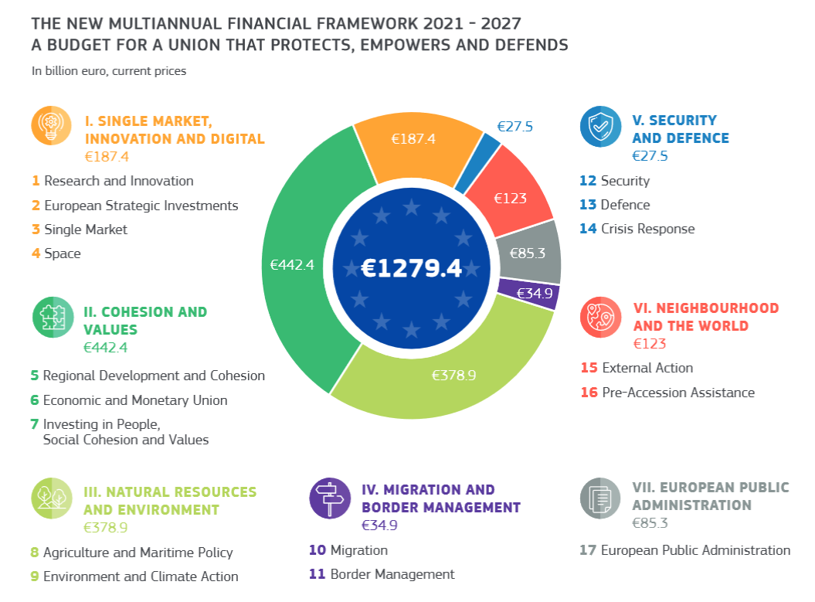

Slide 5
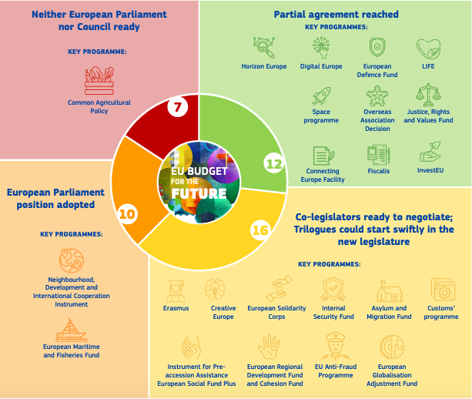
CURRENT SITUATION OF SECTORAL
LEGISLATIVE PROPOSALS

Slide 6
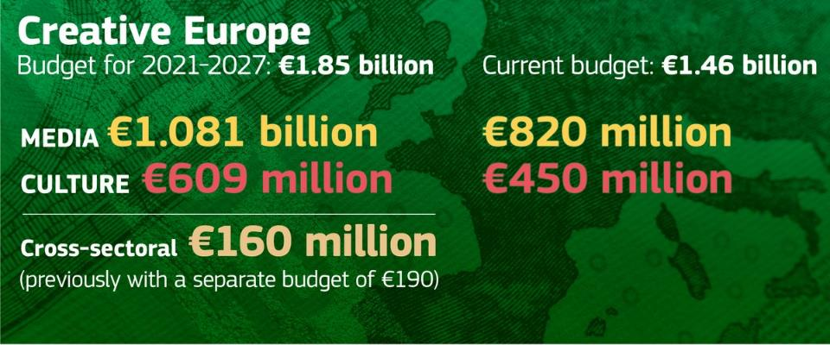
Creative Europe 2021 - 2027
Promote European cooperation on cultural and linguistic diversity and heritage
Increase the competitiveness of the cultural and creative sectors, in particular the audiovisual sector

Slide 7
Creative Europe - Culture strand
A budget of €610 million to:
Promote cross-border circulation of operators and works
Increase cultural participation and social inclusion
Generate jobs and growth within the cultural and creative sectors
Strengthen European identity and values
Contribute to international relations through cultural diplomacy
What’s new
New individual cross-border mobility scheme for artists and cultural professionals
More support for promotion of European cultural and creative works beyond the EU
Sectorial approach for specific sectors such as music, books and publishing, architecture and cultural heritage, design, fashion and cultural tourism

Slide 8
A pilot project on cross-border mobility of artists and culture professionals
500 persons in two sectors: Performing Arts and Visual Arts
Three calls between April and September 2019
Details on www.i-portunes.eu on 15 April 2019
i-Portunes is implemented on behalf of the European Commission by Goethe-Institut, in consortium with the Institut français, Izolyatsia and Nida Art Colony of Vilnius Academy of Arts.

Slide 9
Creative Europe - Cross sectoral strand
A Budget of €160 million to:
Strengthen a free, diverse and pluralistic media environment, qualitative journalism and support media literacy
Promote innovative approaches to content creation, access, distribution and promotion across cultural and creative sectors
Promote the programme and its funding opportunities (Creative Europe Desks)
What’s new
More opportunities for out-of-the-box thinking and innovation across sectors
More stability of funding for actions supporting free, diverse, and pluralistic media & media literacy

Slide 10
The new Creative Europe Programme
https://eur-lex.europa.eu/legal-content/EN/TXT/HTML/?uri=CELEX:52018PC0366&from=EN
The new EU Research programme Horizon Europe
https://ec.europa.eu/commission/sites/beta-political/files/budget-may2018-horizon-europe-regulation-annexes_en.pdf
European innovation ecosystems: Connecting with regional and national innovation actors and supporting the implementation of joint cross-border innovation programmes by Member States and associated countries, from the enhancement of soft skills for innovation to research and innovation actions, to boost the effectiveness of the European innovation system. This will complement the ERDF support for innovation eco-systems and interregional partnerships around smart specialisation topics.
The new InvestEU programme:
https://ec.europa.eu/commission/sites/beta-political/files/budget-may2018-investeu-regulation_en.pdf
Should contribute to the support of European culture and creativity. The InvestEU Fund should operate under four policy windows: sustainable infrastructure; research, innovation and digitisation: SMEs; and social investment and skills. It will also support cultural activities with a social goal.
The new Digital Europe Programme
https://ec.europa.eu/commission/sites/beta-political/files/budget-june2018-digital-europe-annex_en.pdf
Will provide creators and creative industry in Europe with access to latest digital technologies from AI to advanced computing. Exploit the European cultural heritage as a vector to promote cultural diversity, social cohesion and European citizenship. It will also establish a network of Digital Innovation Hubs.

Slide 11
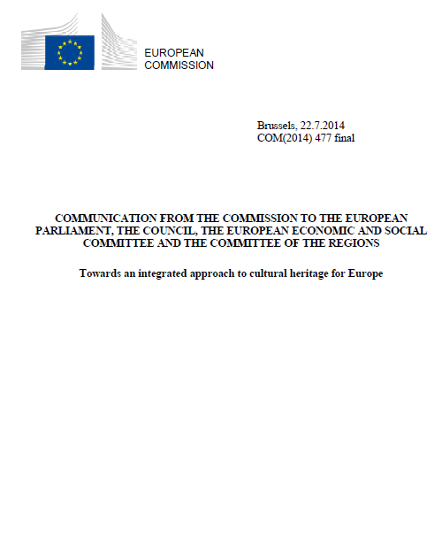
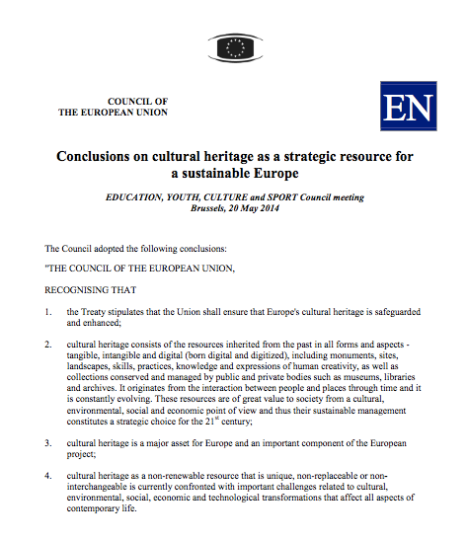
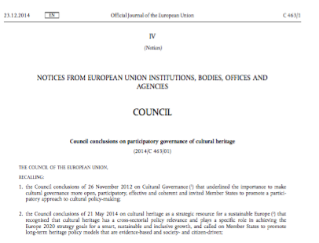
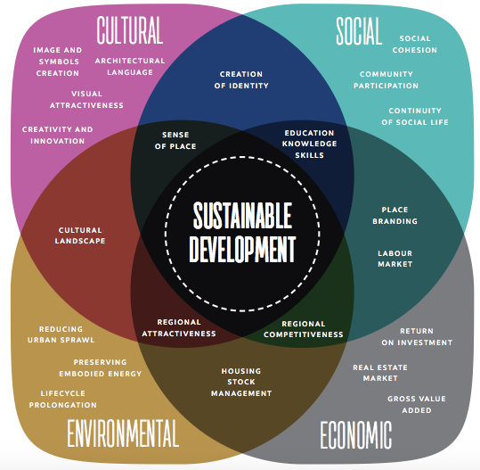
The European approach to cultural heritage
People and communities
Holistic and integrated approach
Participation / sharing responsibilities
Value awareness / generation
Regenerative development
EU Policy framework on CH
European Landscape convention
Faro Convention
Davos declaration on Baukultur
CoE Strategy 21
Cultural Heritage Counts for Europe report (2015)
http://blogs.encatc.org/culturalheritagecountsforeurope/outcomes/
CITIZENSHIP
CULTURE
MARITIME
RESEARCH
ENVIRONMENT
TOURISM
AGRICULTURE
EDUCATION
COHESION
EXT RELATIONS
CUSTOM

Slide 12
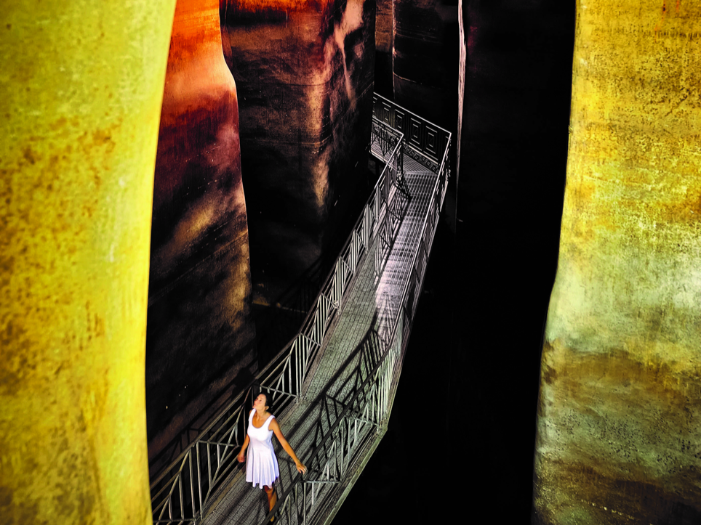
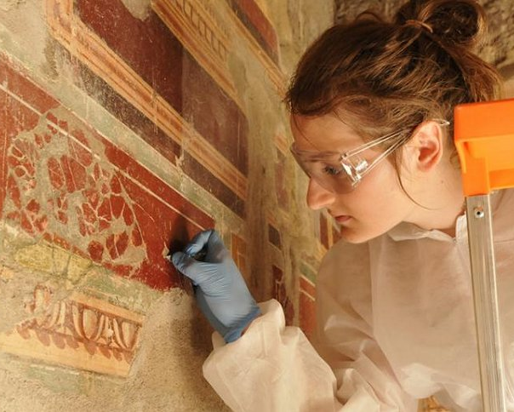
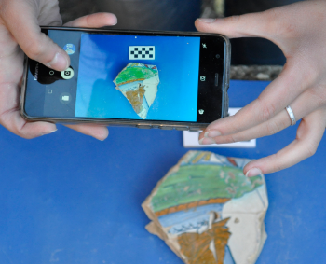
ENGAGEMENT
SUSTAINABILITY
INTERNATIONAL
PROTECTION
INNOVATION

Slide 13
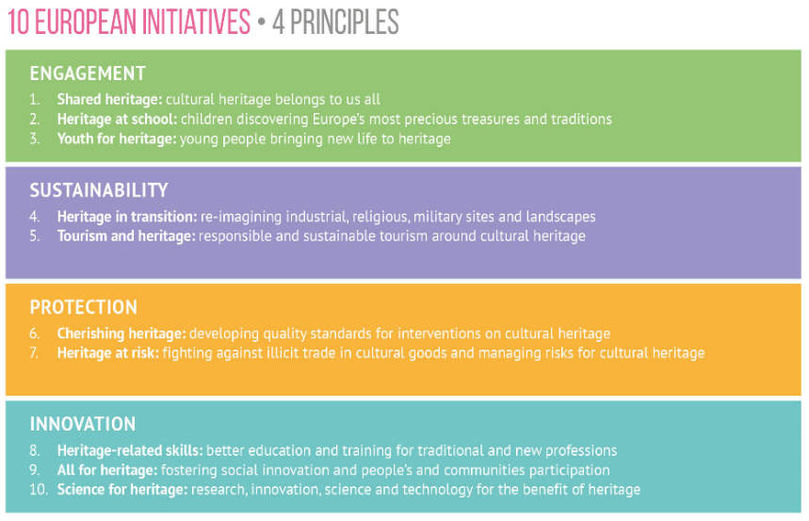
European Year of Cultural Heritage

Slide 14
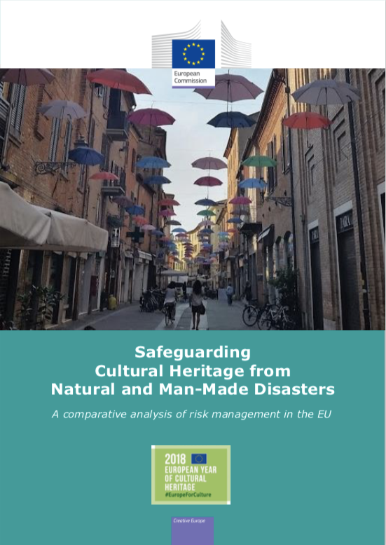
It works!
37 countries
38 stakeholder organisations
19 Commission’s DGs
EU institutions/bodies
Over 18 000 events reaching 10 million people
14 000 labelled projects and events. incl. over 900 EU funded projects (Horizon 2020,Erasmus +, Interreg, etc)
30 million visitors to European Heritage Days (70 000 events).

Slide 15
European Framework for Action on Cultural Heritage
LEGACY of the EYCH 2018
Momentum: engagement of stakeholders, Member States and EU institutions
Continuity: without prejudice to the next MFF
Common direction at European level, primarily in EU policies and programmes
Inspiration for Member States, Regions and cities, organisations, networks

Slide 16
European Framework:
4 key principles, 5 areas, over 65 actions
Cultural heritage for an inclusive Europe:
participation and access for all
Holistic
Mainstreaming and integrated
Evidence-based policy making
Multi-stakeholder (Cultural Heritage Forum)
Cultural heritage for a sustainable Europe:
Smart solutions for a cohesive and sustainable future
Cultural heritage for a resilient Europe:
Safeguarding endangered heritage
Cultural heritage for an innovative Europe:
Mobilising knowledge and research
Cultural heritage for stronger global partnerships:
Reinforcing international cooperation

Slide 17
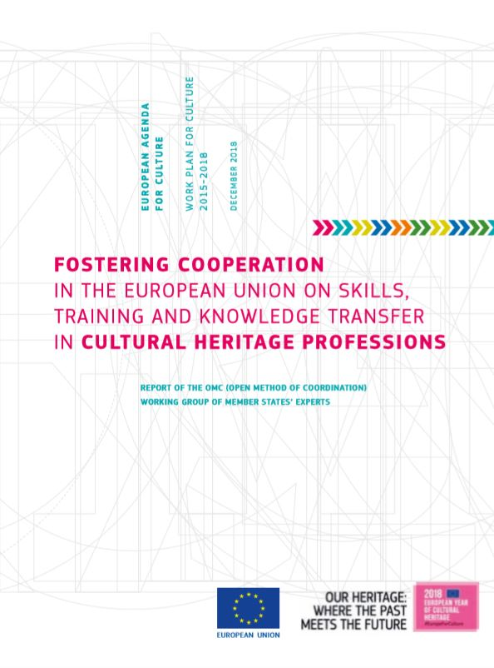
What’s next?
Cluster 12: Boosting skills in cultural heritage professions
2019 Fostering cooperation in the European Union on skills, training and knowledge transfer in cultural heritage professions. OMC Report of Working Group of Member States
Development of qualified professionals and improvement in knowledge management and knowledge transfer in the cultural heritage sector through projects (Erasmus+)
Map skills at risk, gather statistical evidence, define occupational profiles and develop frameworks for raising awareness and attracting the young generations to heritage professions. (Erasmus+ Sector Skills Alliances Blueprint for Skills, Pilot Project FLIP 2, revision of NACE 2.0)

Slide 18
"FLIP (Finance, Learning, Innovation and Patenting) for CCIs" - 1
Policy project, EP Pilot Project 2018
Timing: February 2019-21 (1m€)
Objectives:
•Define and test policies and actions for sustaining and developing CCIs,
•Generate cross-sectoral benefits and spill-overs in the different areas and sectors CCIs interface with
Areas of action:
▪skill classification model for CCIs
▪CCI-skills and traditional education and skills development systems
http://creativeflip.creativehubs.net/#hero
https://ec.europa.eu/culture/calls/pilot-project-cultural-and-creative-industries_en

Slide 19
"FLIP (Finance, Learning, Innovation and Patenting) for CCIs" - 2 - NEW CALL!
EP Pilot Project 2019
Timing: to start early-2020, 2 year project), 1,05 m€
Call for proposals EAC/S12/2019, 1 proposal to be funded,
deadline for submission: 12/08/2019
Objectives:
•to bridge the gap between cultural heritage education and skills development and the labour market
•to encourage connections with creative industries and "third places" such as creative hubs, maker spaces, fablabs, cultural centers, community centers or other.
Areas of action:
▪skill enhancement model for CCIs
▪CCI-skills and traditional education and skills development systems
https://ec.europa.eu/culture/calls/eac-s12-2019_en

Slide 20
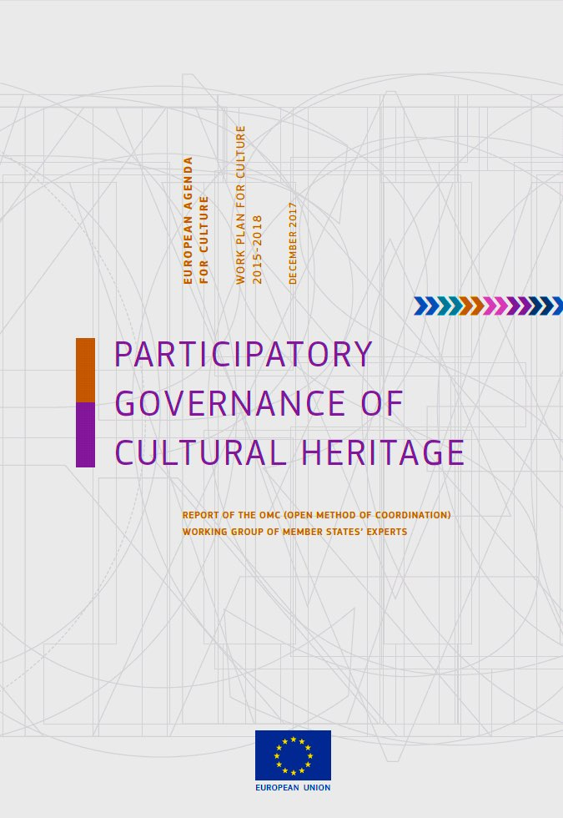
INNOVATION

Slide 21
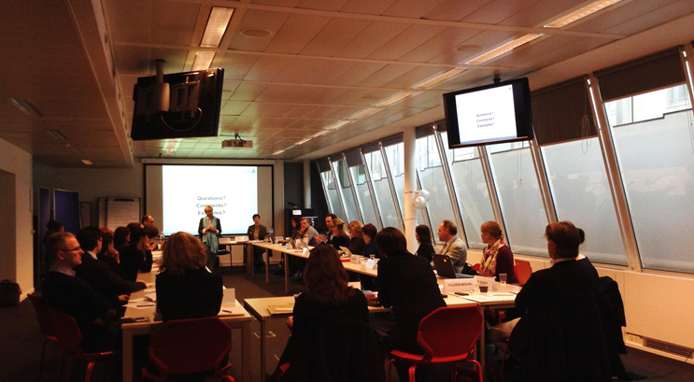
Pragmatic approach
From an abstract notion to concrete action:
How participation can be used in the ordinary governance of cultural heritage?
How to facilitate the recognition of the importance of PGCH by institutions and professionals?
How and when to use it in the best possible way?
Building on practices/cases and analysis of processes, benefits, obstacles, motivation, lessons learned + Participatory methods
Not a cure-all or a one-size-fits-all method
can start at all stages of the policy cycle, if this enables civil society

Slide 22
The Faro Way
Increased role of civil society and communities in heritage governance
increase number of European states ratifying the Council of Europe Convention on the Value of Cultural Heritage for Society (Faro Convention)

Slide 23
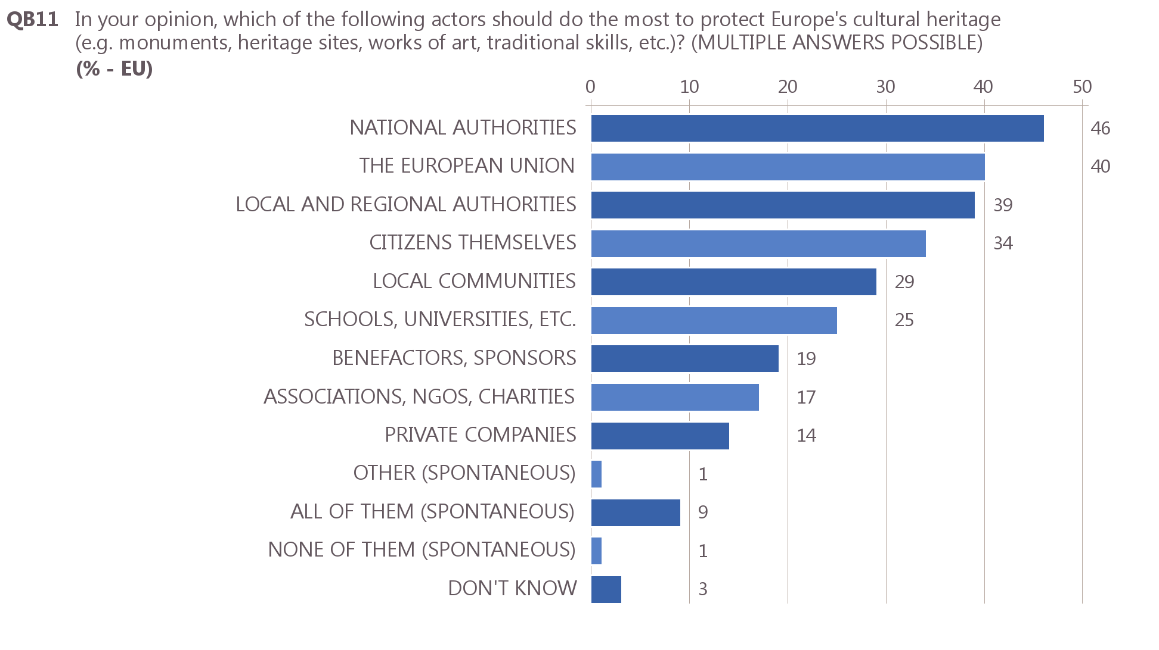
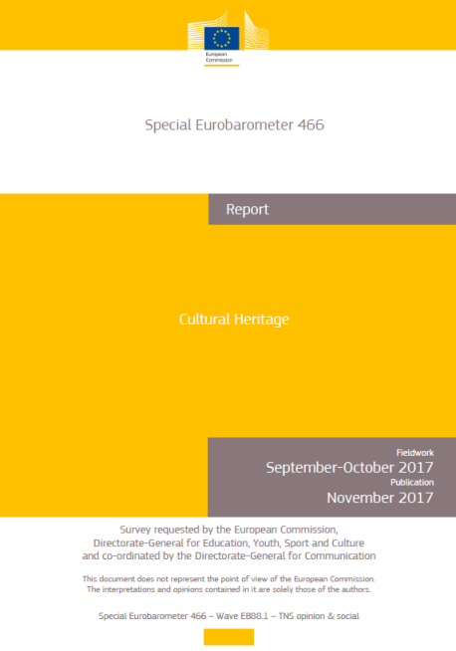
Eurobarometer on
cultural heritage
Public authorities should allocate more resources to Europe’s CH (74%).
Actors that should do the most are national authorities (46%), the EU (40%), local and regional authorities (39%) or citizens (34%).
Culture

Slide 24
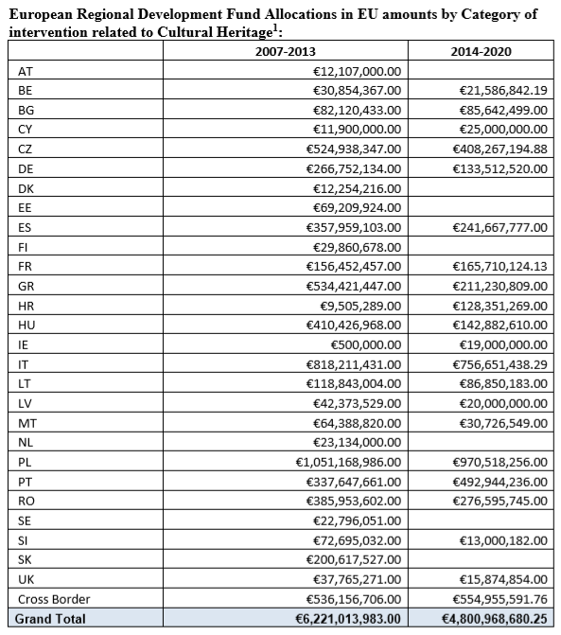
(2007-2013 and 2014-2020)
EUR 11 billion of European Regional Development Fund support allocated to Cultural Heritage!
(1)
2007-2013 period includes categories 58 – preservation of cultural heritage, 59 cultural infrastructure and 60 cultural services.
2014-20 includes categories 94 Protection, development and promotion of public cultural and heritage assets, 95 - Development and promotion of public cultural and heritage services

Slide 25
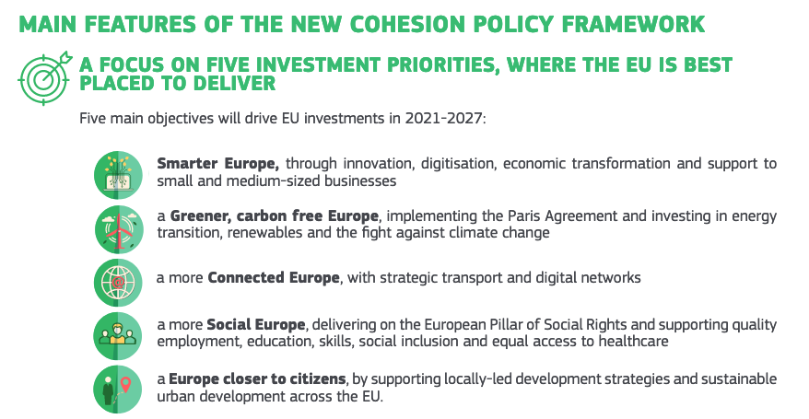
(i) fostering the integrated social, economic and environmental development, cultural heritage and security in urban areas;
(ii)fostering the integrated social, economic and environmental local development, cultural heritage and security, including for rural and coastal areas also through community-led local development.

Slide 26
Cluster 8 - Quality of interventions on cultural heritage

Slide 27
Cluster 8: Raising the quality of interventions in the European historical environment on cultural heritage sites
Policy input: Resolution of the EP on CH (2015), Latvian Presidency Conference, Heritage, Contemporary Architecture and Design in Interaction (2015), Council conclusions Bringing cultural heritage to the fore across policies in the EU (2018)
Objective of the EYCH 2018 'promote debate, research and the exchange of good practices on the quality of conservation, safeguarding, innovative re-use and enhancement of cultural heritage, and on contemporary interventions in the historical environment’.
European Initiative n. 6 Cherishing heritage

Slide 28
European Quality Principles for EU-funded Interventions with potential impact upon Cultural Heritage
Focus on EU-funded interventions with potential impact on cultural heritage
Mainly built heritage and cultural landscapes, but intangible is taken into account
Awareness raising: Environmental, cultural, social and economic benefits of the implementation of conservation principles and standards
http://openarchive.icomos.org/2083/1/European_Quality_Principles_2019_EN.PDF

Slide 29
Quality - From impacts to value generation
Quality & Expertise
Quality & Process
Quality & Regenerative development
Quality is a shared responsibility
Benefits people and communities
Relies on cooperation and participation
Cultural Heritage Counts for Europe report (2015)
http://blogs.encatc.org/culturalheritagecountsforeurope/outcomes/
© European Heritage Label
Notes:
© Pol Englebert Joutes

Slide 30
Shared resource = Shared responsibility
Guidance for all stakeholders directly or indirectly engaged (i.e. European institutions, managing authorities, international organisations, civil society and local communities, private sector, and experts).
Step by step implementation: Programming, Project briefs and tenders, Design, Procurement, Implementation, Monitoring and evaluation
Drivers: Governance, Risk assessment and mitigation, Research, Education and training, Rewarding quality
Tools:
key concepts, international charters, European and international conventions, standards
Key research outcomes and 40 specific recommendations
Checklist of Selection criteria for decision makers
© European Heritage Label
Notes:
Purpose of the Year stated in Art 1 of
DECISION (EU) 2017/864

Slide 31
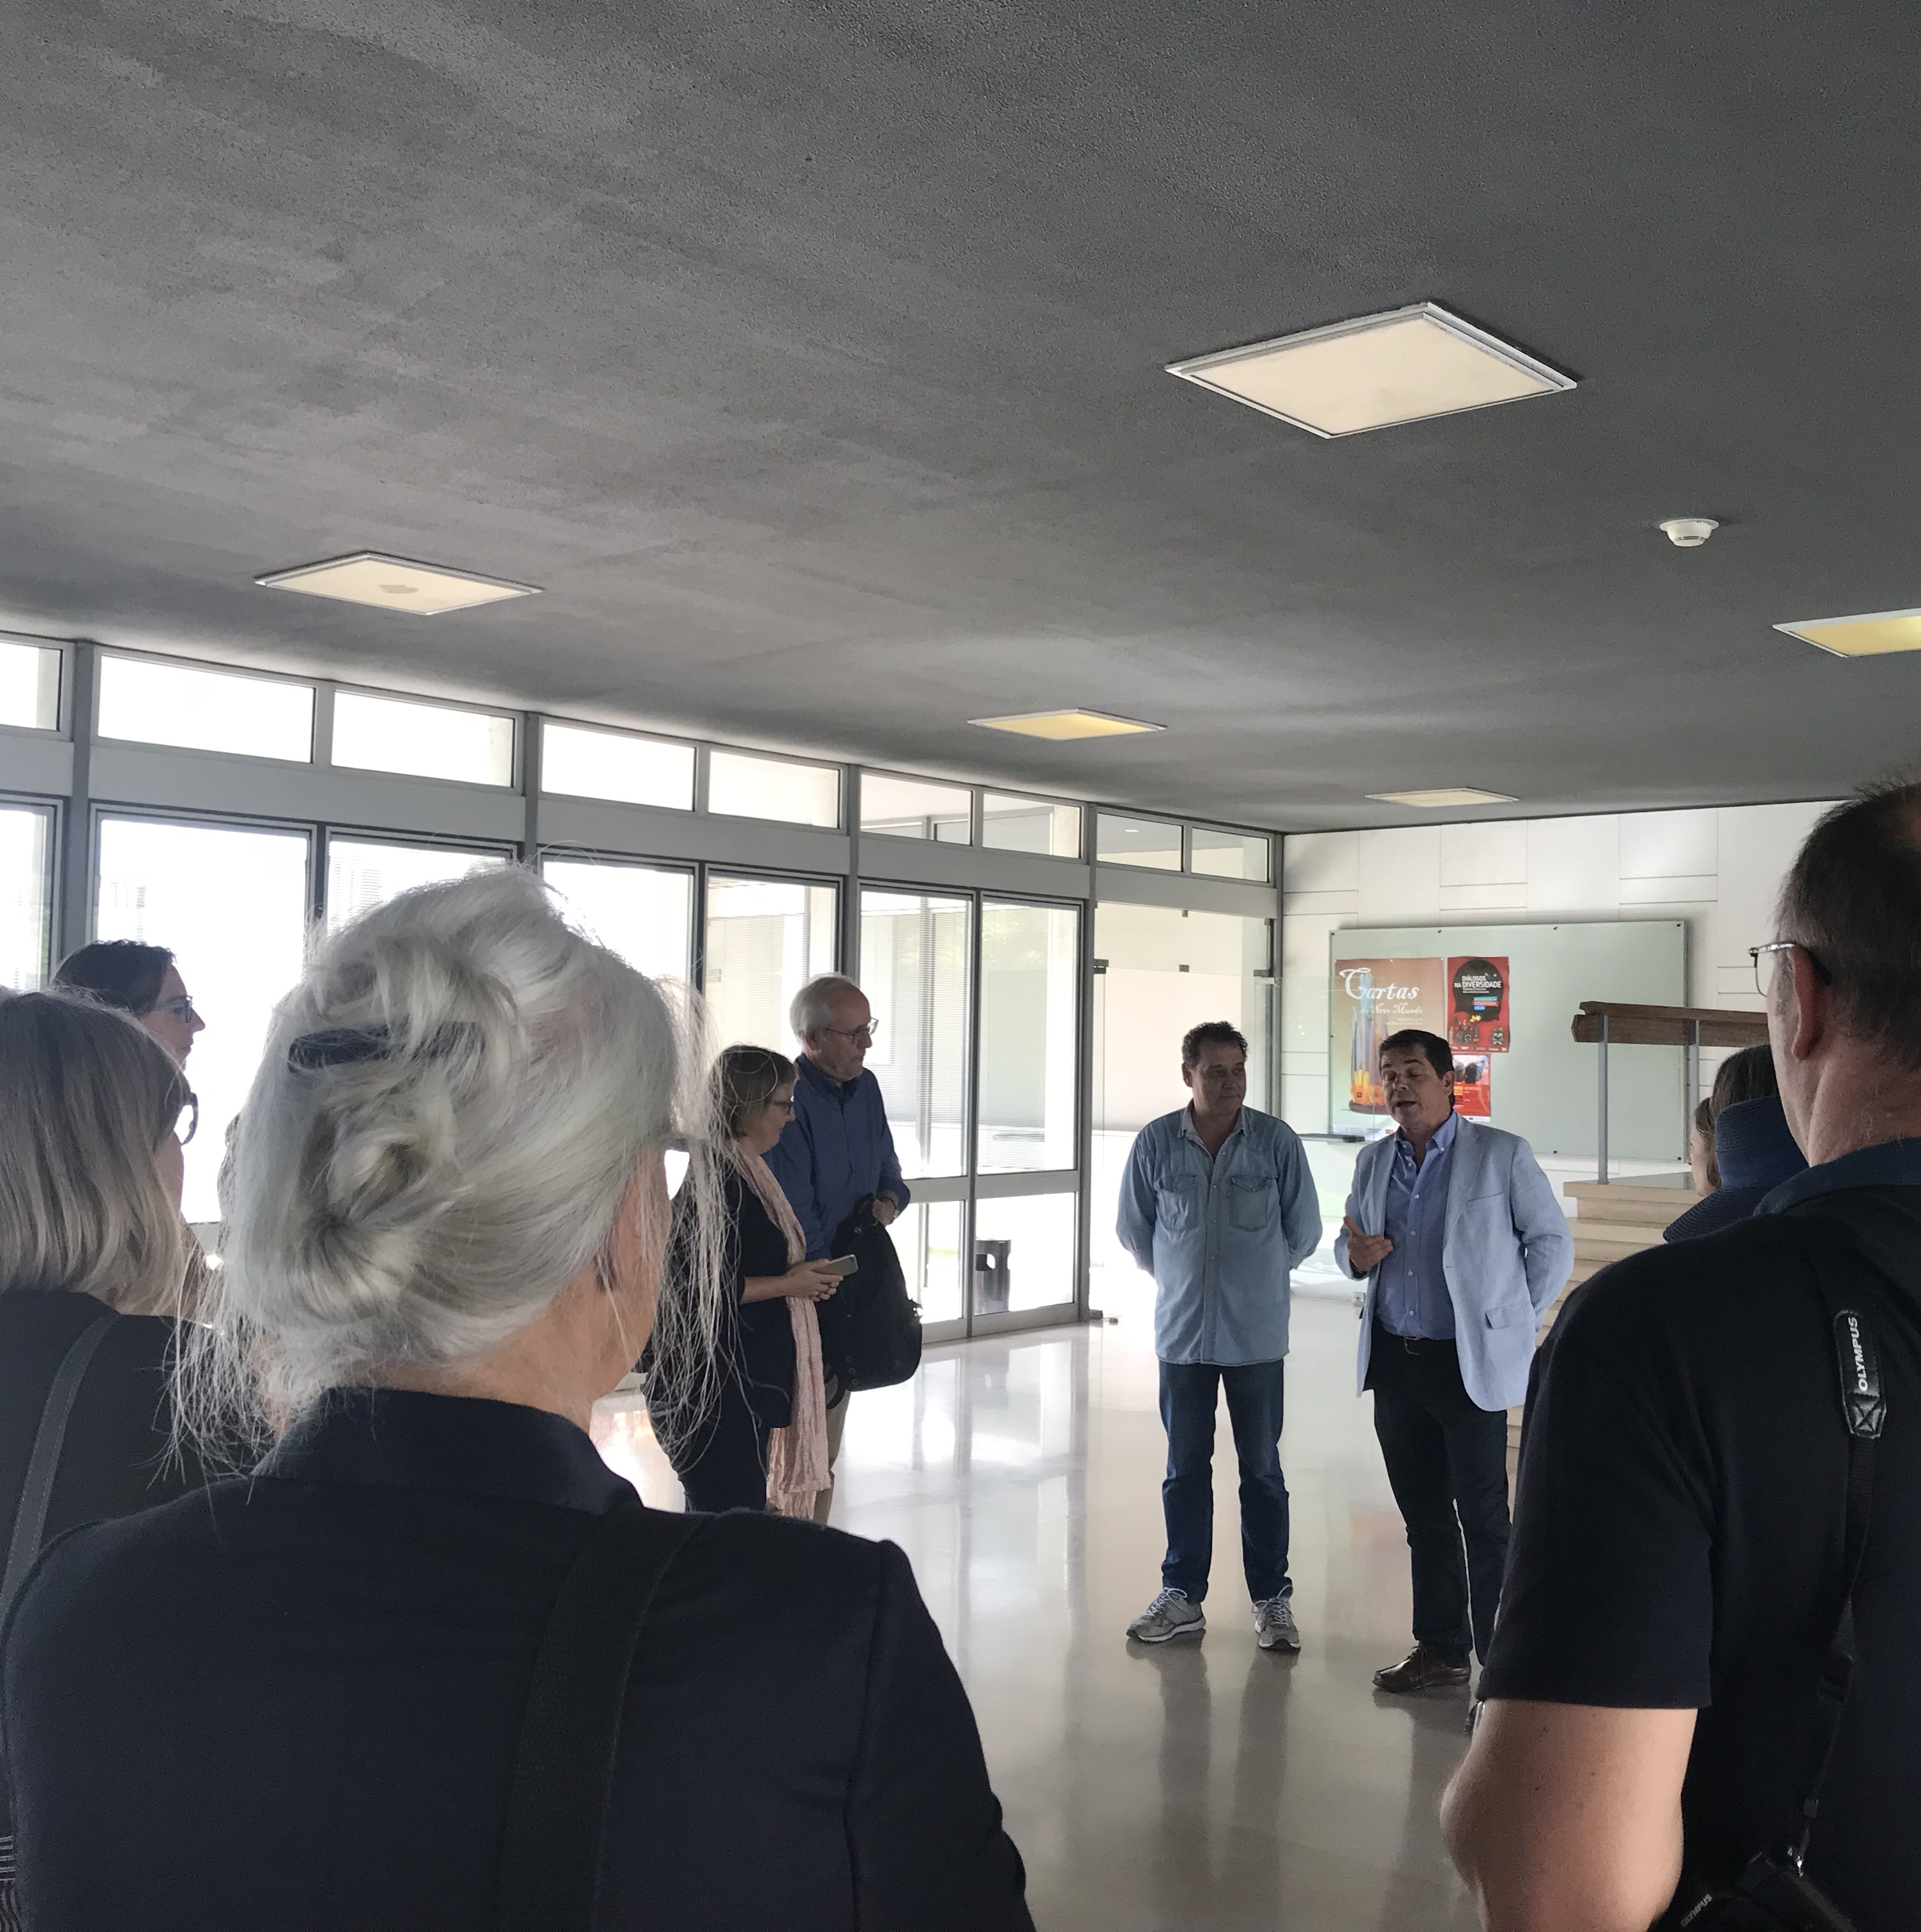
2020-2021 Peer-learning and study visits for cities, regions, national/European experts on cultural heritage good practices
What’s next?
Cluster 8: Raising the quality of interventions in the European historical environment on cultural heritage sites
Quality principles for EU funded interventions on CH (with ICOMOS)
Autumn 2019 - Horizon 2020 Social platform on the impact assessment and the quality of interventions in European historical environment and cultural heritage sites (CSA) 1,5 MEur
•Call for tender to be launched 3rd quarter this year, mentioned in WP for culture and Framework
Quality for CH and participatory governance
•https://ec.europa.eu/programmes/creative-europe/sites/creative-europe/files/library/c-2018-6687.pdf (p. 119)

Slide 32
Urban Innovative Actions
• Testing new solutions on the urban level (for cities >50k inhabitants), financed thru ERDF and manage by UIA Secretariat in Lille, up to 80% of project activities and up to 5 M EUR ERDF money
• 5th call for proposals to be launched in September 2019 tbc (DDL December 2019), 4 topics: Air quality, Circular economy, Culture and Cultural Heritage, Demographic change
• Topic papers and further info available here: https://www.uia-initiative.eu/en/call-proposals/5th-call-proposals

Slide 33
Pilot project Makers' Mobility
EP Pilot Project 2019 – NEW CALL
Timing: to start early-2020 (2 year project), 350.000€
Call for proposals EAC/S09/2019, 1 proposal to be funded,
deadline for submission: 12/08/2019
Objectives: to define and test policies and actions supporting the mobility and exchanges of experience between the cultural and creative industries, creative hubs, maker-spaces, fab-labs and formal and non-formal learning and skills development systems in a cross-sectoral way.
Areas of action:
▪Mapping, needs assessment, recommendations, some exchanges
▪https://ec.europa.eu/culture/calls/eac-s09-2019_en

Slide 34
Measuring the cultural and
creative sectors in the EU
EP Pilot Project 2019 – NEW CALL
Timing: call for proposals to be published end-2019,
350.000€, 1 proposal to be funded
Objectives: to fill the existing gaps at Eurostat level on the CCS and consider the feasibility of creating a statistical framework that would enable regular statistical analysis of the economic, cultural and social potential of the CCS in Europe.
More info:
https://ec.europa.eu/programmes/creative-europe/sites/creative-europe/files/2019-annual-work-programme.pdf

Slide 35
Cultural and Creative Spaces and Cities
Policy project, funded under the Cross-Sectoral Strand of Creative Europe
Timing: started end-2018, for 2 years, 1,5m€
Objectives:
-bring closer together cultural and creative spaces and local decision-makers,
-help to better valorise public spaces for social and urban regeneration through culture,
-share best practice concerning social inclusion and the relations of cultural and creative spaces with their neighbourhoods
-explore and share best practice of cultural and creative spaces with aspects of the collaborative economy and innovative models for the delivery of public services.
- http://www.creativespacesandcities.com/

Slide 37
Urban Agenda for the EU
•new Partnership on Culture and Cultural Heritage launched
•https://ec.europa.eu/futurium/en/culturecultural-heritage/about-0
•https://ec.europa.eu/futurium/en/urban-agenda https://ec.europa.eu/futurium/en/culture-and-cultural-heritage
•(two meetings took place, in Berlin and Brussels, next: presence at European Week of Regions and Cities in October 2019 in Brussels)

Slide 38
Thank you!
https://europa.eu/cultural-heritage
https://ec.europa.eu/culture/content/european-framework-action-cultural-heritage_en
#EuropeForCulture
Legal basis EYCH

